Slide 1

Welcome to
SEIN CONSULTING
At SEIN Consulting, we believe that technology can be a powerful force for good. We started our journey in the wellness industry, where we helped people achieve their health and fitness goals through innovative solutions.
Now, we're applying that same passion for innovation to the world of IT. We've expanded our expertise to cover a wide range of key technologies, and we're dedicated to connecting our clients with the top talent they need to succeed.
Our tailored staffing solutions are designed to meet the unique needs of each client, and our commitment to client satisfaction is at the heart of everything we do. Whether you're looking to build a new IT team or strengthen your existing one, we're here to help.

Slide 2


Our Journey: From Wellness to IT
1
Health & Wellness
SEIN Consulting began as a health and wellness company, providing services to enhance the well-being of individuals and organizations.
2
IT Solutions
Recognizing the growing demand for IT talent, SEIN Consulting expanded its offerings to include IT solutions and staffing services.
3
IT Staffing Experts
Today, SEIN Consulting is a leading provider of IT staffing solutions, connecting clients with top talent in various technical areas.

Slide 3

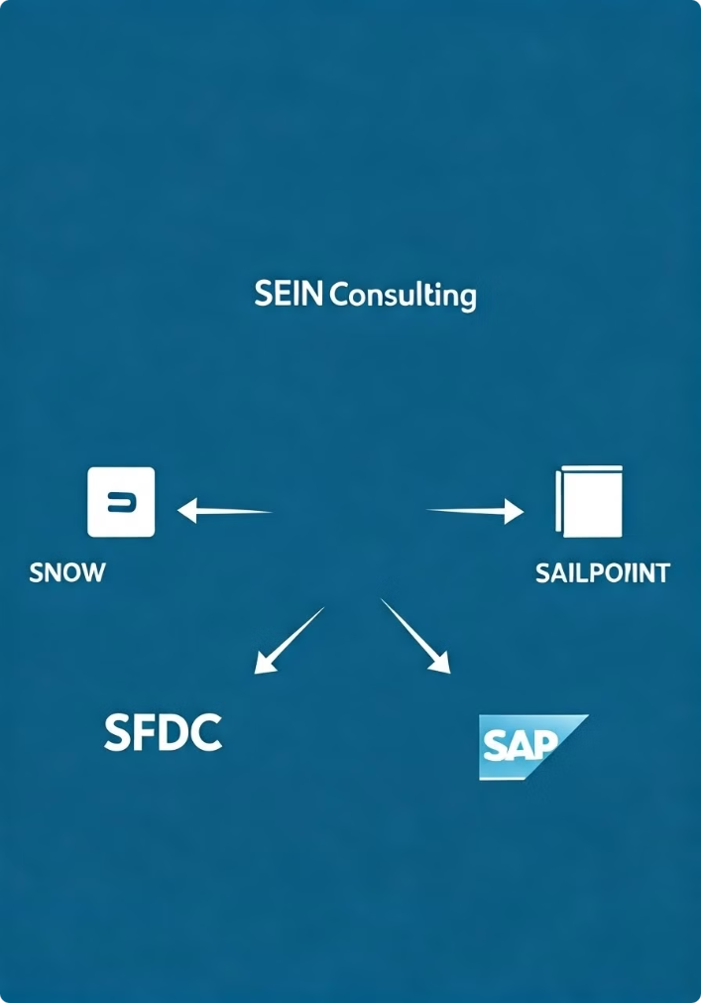
Expertise in Key IT Technologies
SNOW
SFDC
We specialize in finding skilled professionals with expertise in ServiceNow (SNOW), a leading platform for IT service management.
Our team has extensive knowledge of Salesforce (SFDC), the world's leading customer relationship management (CRM) platform.
SAILPOINT
SAP ERP
We connect clients with experienced professionals proficient in SailPoint, a leading identity and access management (IAM) solution.
Our staffing services extend to SAP ERP, a comprehensive enterprise resource planning (ERP) system, helping clients find skilled SAP experts.

Slide 4

Connecting Clients with Top Talent
1
Experienced Recruiters
2
Extensive Network
Our dedicated team of recruiters has a proven track record of finding and placing exceptional IT talent.
We leverage a vast network of skilled professionals to ensure we have access to the best talent in the industry.
3
Rigorous Screening
4
Strong Relationships
We conduct thorough screenings and assessments to ensure that our candidates meet the specific requirements of our clients.
We build lasting relationships with both our clients and candidates, fostering a collaborative and trustworthy environment.

Slide 5
Tailored Staffing Solutions
Contract Staffing
Direct Hire
Custom Solutions
We provide short-term and long-term contract staffing solutions to meet your immediate needs and project requirements.
We assist you in finding permanent employees who will become valuable assets to your organization.
We work closely with you to understand your specific needs and develop a tailored staffing solution that meets your unique requirements.
Proven Track Record of Success
Happy Clients
High Retention Rate
Positive Feedback
Successful Project Delivery

Slide 6




Commitment to Client Satisfaction
Open Communication
We maintain open communication with our clients throughout the entire staffing process.
Trust and Transparency
We build trust by being transparent and honest in all our dealings with clients.
Ongoing Support
We provide ongoing support to our clients, ensuring a seamless experience.

Slide 7


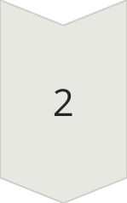
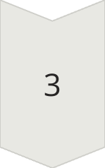
Let's Work Together
Contact Us
Reach out to our team to discuss your staffing needs and explore how we can help you find the best talent.
Share Your Requirements
Tell us about your open positions, desired skill sets, and project timelines.
Experience the Difference
Let SEIN Consulting help you fill your open positions with highly skilled and qualified professionals.

Slide 8


Let's Connect
Have a question about our services, want to discuss a staffing need, or simply want to learn more about SEIN Consulting? We're here to help!
Reach out to us through the following channels:
Contact: Human Resource
Email: info@seincon.com
Phone: +91 7989372170
URL : www.seincon.com

